Slide 1
Dr. Yifeng Zhu Electrical and Computer Engineering University of Maine
Embedded Systems with ARM Cortex-M Microcontrollers in Assembly Language and C
Chapter 16
General-purpose Timers
Fall 2025

Slide 2
Input Capture
Capture the timestamp of the occurrence of a rising or a falling edge transition in a digital signal

Slide 3
ARR=99
63
30
0
External signal
Hardware copies counter to CCR, thus CCR = 63
Hardware generates an interrupt to run timer ISR()
Hardware copies counter to CCR, thus CCR = 30
Hardware generates an interrupt to run timer ISR()
Time span between two events = 63 – 30 = 33 time units

Slide 4



Input Capture
Record the timestamp of an external event
Capture both rising and falling edges
$${Time Span=T_{2}−T}_{1}$$
time
$$T_{1}$$
$$T_{2}$$
External Signal 1
External Signal 2
Measuring low or high time

Slide 5
Input Capture
Capture only rising edges or only falling edges
$${Time Span=T_{2}−T}_{1}$$
time
$$T_{1}$$
$$T_{2}$$
External Signal 1
External Signal 2
Measuring the period

Slide 6
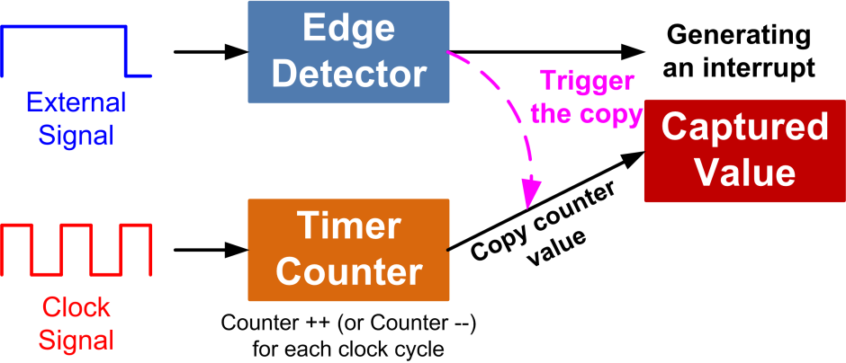
Input Capture
Latch the counter value into CCR after a transition is detected
If enabled, generate an interrupt to inform the processor to read CCR
Hold in CCR
(Capture/Compare register)

Slide 7
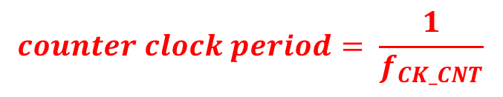

$$f_{CK_CNT}=\frac{f_{CL_PSC}}{PSC+1}$$
f_{CL_PSC}
f_{CL_CNT}
Timer
Counter
PSC
clock
Prescaler
Counter is incremented/decremented once per cycle.
Timer: Upcounting mode, ARR = 6
$$counter clock period= \frac{1}{f_{CK_CNT}}$$
Clock
6
6
6
6
5
5
5
5
4
4
4
4
Counter
3
3
3
3
2
2
2
2
1
1
1
1
0
0
0
0
Notes:
A single timer can generate up to 4 PWM signals with independent duty cycles and identical frequency. When multiple PWM signals are generated by the same timer, all rising edges occur at the same time. That is why it is called edge-aligned.

Slide 8
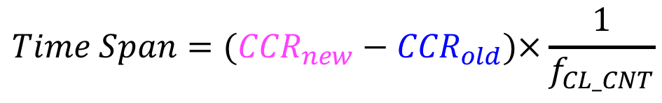

ARR
ARR
Timer
Counter
CCR_{new}
CCR_{old}
0
Capture only rising edges
0
External Input Signal
$$Time Span=({CCR}_{new}−{CCR}_{old})×\frac{1}{f_{CL_CNT}}$$
$$f_{CK_CNT}=\frac{f_{CL_PSC}}{PSC+1}$$

Slide 9
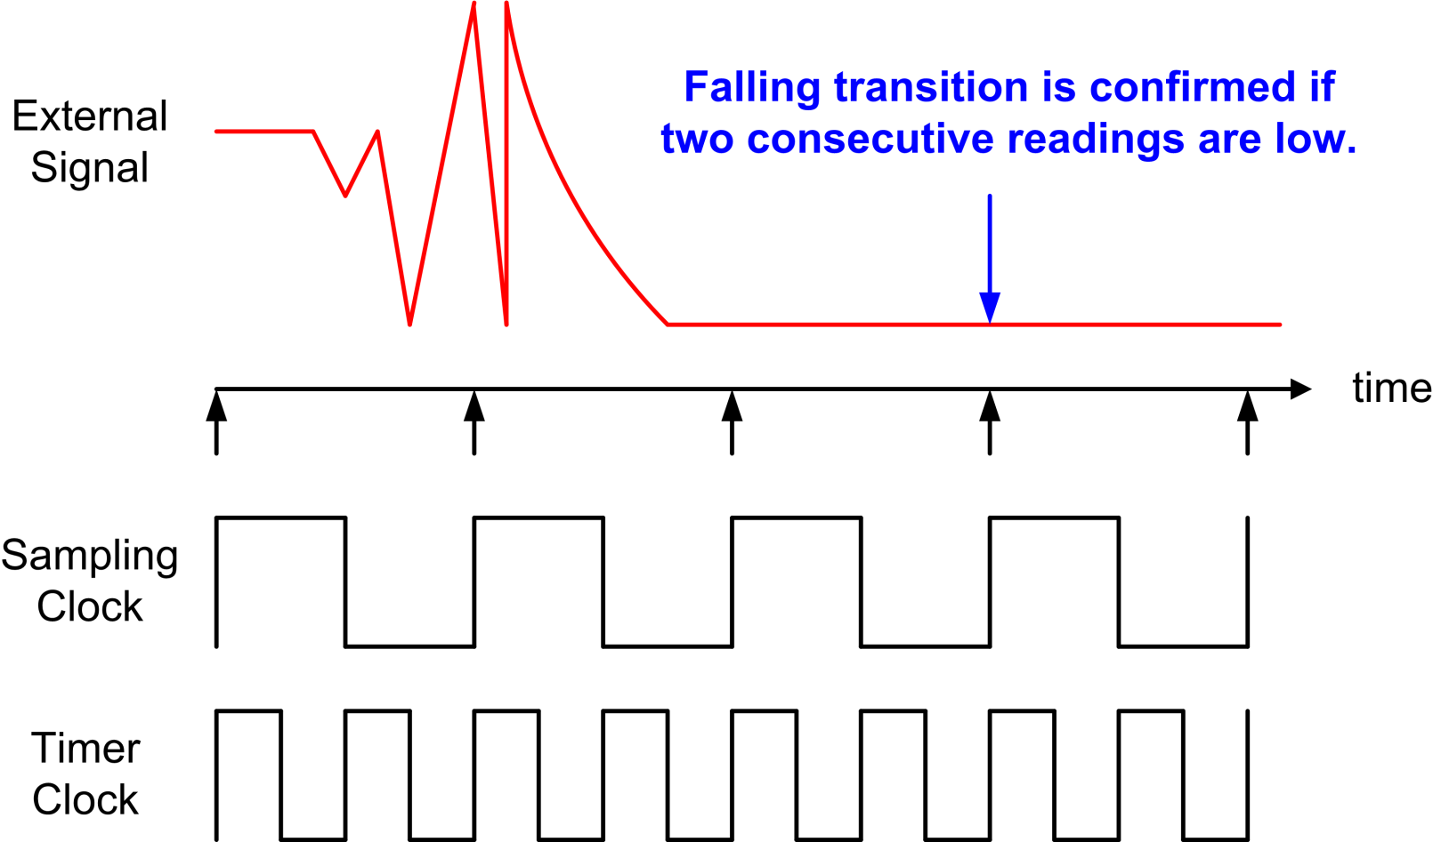
Input Filtering
Digital filter for debouncing and noise removal
N consecutive samples with the new level
Filter acceptance = 2

Slide 10
Input Prescaler
Assume capture only rising edge
External Signal
Capture every rising edge
Capture every 2 rising edges
Capture every 4 rising edges

Slide 11
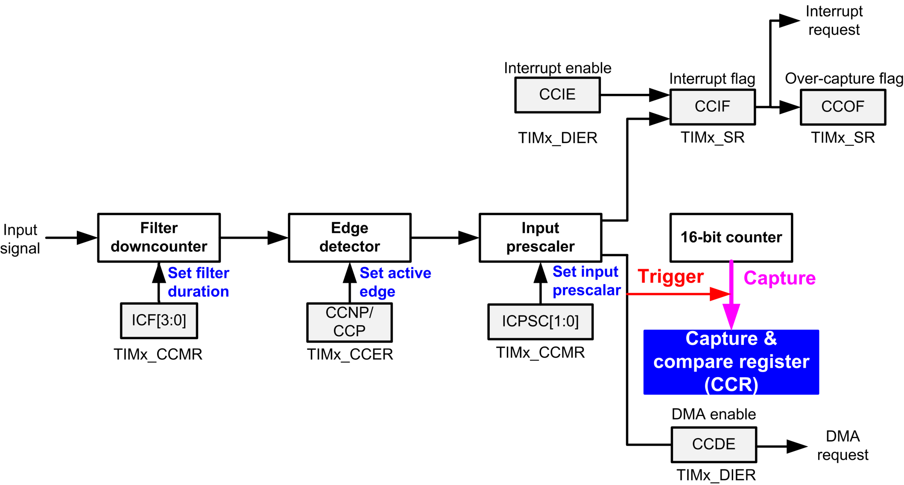
Input Capture Diagram

Slide 12
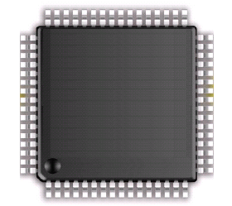
Quiz: Input Capture
How does software know a capture event occur?
via interrupt

Slide 13
Recall: Enable an Interrupt
Peripheral
Interrupt Request
ARM Cortex-M
NVIC
Interrupt Request
Execution
Core
Two steps:
Program the peripheral control register to allow it to generate interrupts
Program NVIC to allow it to accept interrupts
Nested Vectored Interrupt Controller

Slide 14
Timer DMA/Interrupt Enable Register (DIER)
1 = enable, 0 = disable
…
7 | 6 | 5 | 4 | 3 | 2 | 1 | 0
... | TIE | COMIE | CC4IE | CC3IE | CC2IE | CC1IE | UIE
UIE: Update Interrupt Enable
CC1IE: Capture/compare Channel 1 Interrupt Enable
CC2IE: Capture/compare Channel 2 Interrupt Enable
CC3IE: Capture/compare Channel 3 Interrupt Enable
CC4IE: Capture/compare Channel 4 Interrupt Enable
TIE: Trigger Interrupt Enable
...

Slide 15
Timer DMA/Interrupt Enable Register (DIER)
1 = enable, 0 = disable
…
8 | 6 | 5 | 4 | 3 | 2 | 1 | 0
BIE | TIE | COMIE | CC4IE | CC3IE | CC2IE | CC1IE | UIE
Enable interrupt
TIM4->DIER |= 0x02; // Enable interrupt for channel 1
NVIC_EnableIRQ(TIM4_IRQn); // Enable interrupt for timer 4
Disable interrupt
TIM4->DIER &= ~0x02; // Disable interrupt for channel 1
NVIC_DisableIRQ(TIM4_IRQn); // Disable interrupt for timer 4

Slide 16
Find out the interrupt event
For a timer, multiple events can trigger an interrupt
How does the software know which event has trigger the interrupt?
channel 4 interrupt
OR Gate
timer interrupt
channel 3 interrupt
channel 2 interrupt
channel 1 interrupt
counter update (counter overflow or underflow)

Slide 17
Find out the interrupt event
void TIM4_IRQHandler (void) {
if(TIM4->SR & TIM_SR_UIF) { // UIF Interrupt
...
} else if (TIM4->SR & TIM_SR_CC1IF) { // Channel #1
...
} else if (TIM4->SR & TIM_SR_CC2IF) { // Channel #2
...
}
...
}

Slide 18
Find out the interrupt event
void TIM4_IRQHandler (void) {
if(TIM4->SR & TIM_SR_UIF) { // UIF Interrupt
TIM4->SR &= ~TIM_SR_UIF; // Clear interrupt flag
...
} else if (TIM4->SR & TIM_SR_CC1IF) { // Channel #1
TIM4->SR &= ~ TIM_SR_CC1IF; // Clear interrupt flag
...
} else if (TIM4->SR & TIM_SR_CC2IF) { // Channel #2
TIM4->SR &= ~ TIM_SR_CC2IF; // Clear interrupt flag
...
}
...
}
Hardware sets these flags, and software needs to clear them.

Slide 19
Timer Status Register (SR)
TIMx_SR = 0 (default)
…
8 | 6 | 5 | 4 | 3 | 2 | 1 | 0
BIF | TIF | COMIF | CC4IF | CC3IF | CC2IF | CC1IF | UIF
UIF is set by hardware and needs to be cleared by software.
if (TIM4->SR & 0x01 == 0x01) { // Test UIF
// If hardware sets UIF, do some actions
...
// Clear UIF
TIM4->SR &= ~0x01;
}

Slide 20
Timer Status Register (SR)
TIMx_SR = 0 (default)
…
8 | 6 | 5 | 4 | 3 | 2 | 1 | 0
BIF | TIF | COMIF | CC4IF | CC3IF | CC2IF | CC1IF | UIF
CC1IF: Capture/Compare 1 interrupt flag
If channel CC1 is configured as output, this flag is set by hardware when the counter matches the compare value, with some exception in center-aligned mode. It is cleared by software.
0: No match.
1: The content of the counter TIMx_CNT matches the content of the TIMx_CCR1 register.
When the contents of TIMx_CCR1 are greater than the contents of TIMx_ARR, the CC1IF bit goes high on the counter overflow (in upcounting and up/down-counting modes) or underflow (in downcounting mode)

Slide 21
Timer Status Register (SR)
TIMx_SR = 0 (default)
…
8 | 6 | 5 | 4 | 3 | 2 | 1 | 0
BIF | TIF | COMIF | CC4IF | CC3IF | CC2IF | CC1IF | UIF
CC1IF: Capture/Compare 1 interrupt flag
If channel CC1 is configured as input, this bit is set by hardware on a capture. It is cleared by software or by reading the TIMx_CCR1 register.
0: No input capture occurred
1: The counter value has been captured in TIMx_CCR1 register (An edge has been detected on IC1 which matches the selected polar

Slide 22
Channel 1 for Input Capture
e.g. capture is done once every 4 events
Define the frequency and the length of sampling
e.g. 1000: f_{SAMPLING} = f_{DTS}/8, N = 6
IC1PSC[1:0]
CC1NP/CC1P
00, noninverted/rising edge
01: inverted/falling edge
10: reserved
11: noninverted/both edges

Slide 23
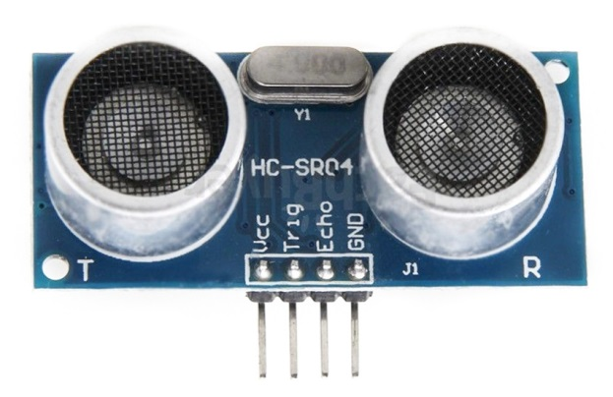
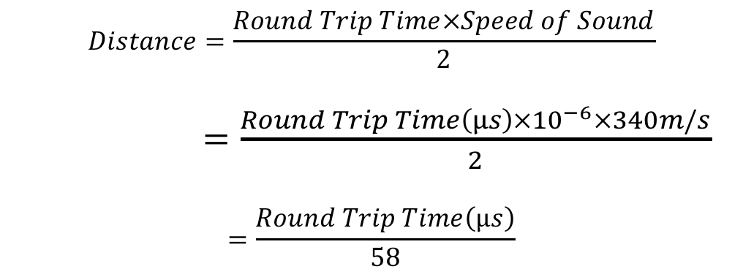
Ultrasonic Distance Sensor
$$Distance=\frac{Round Trip Time×Speed of Sound}{2}$$
$=\frac{Round Trip Time\left(µs\right)×{10}^{−6}×340m/s}{2}$
$$=\frac{Round Trip Time\left(µs\right)}{58}$$

Slide 24
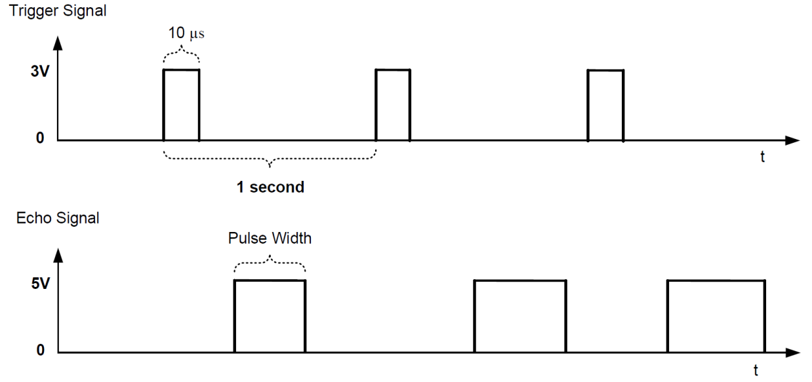
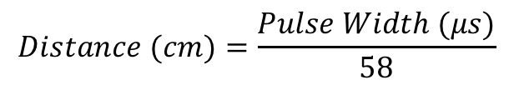
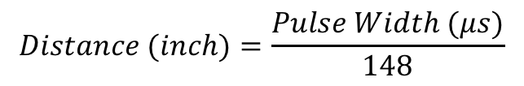
Ultrasonic Distance Sensor
The echo pulse width corresponds to round-trip time.
$$Distance (cm)=\frac{Pulse Width (μs)}{58}$$
or
$$Distance (inch)=\frac{Pulse Width (μs)}{148}$$
If pulse width is 38ms, no obstacle is detected.

Slide 25
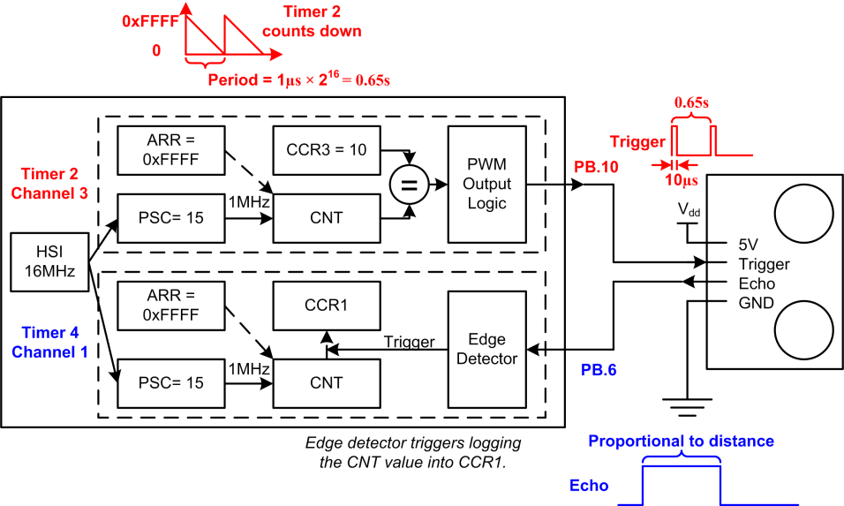
Ultrasonic Distance Sensor

